Slide 1
SATHISH KUMAR M
Generative AI Project

Slide 2
Image Captioning using Deep Learning
Image registration using deep learning uses neural networks to automatically create textual annotations for the images.
This technology combines computer vision (to understand the content of an image) with natural language processing (to provide coherent and relevant text descriptions).

Slide 3


AGENDA
PROBLEM STATEMENT
PROJECT OVERVIEW
END USERS
SOLUTION
MODELLING
RESULTS
3/21/2024 Annual Review

Slide 4

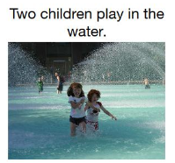
PROBLEM STATEMENT
Given an enter photograph, the goal is to expand a deep mastering version that routinely generates a descriptive caption that accurately describes the content of the image in natural language.

Slide 5

PROJECT OVERVIEW
A robust deep learning model capable of accurately generating descriptive headlines for detailed images.
An implemented framework that can be used to increase the understanding and accessibility of visualization in applications.
Insights gained from the project and best practices can guide future research and development efforts in the field of visualization using deep learning.

Slide 6

WHO ARE THE END USERS?
Visually Impaired Individuals
Content Creators and Publishers
Image Search Engines
E-commerce Platforms
Educators and Students
Healthcare Professionals
Multimedia Applications Developers
Social Media Users

Slide 7

YOUR SOLUTION AND ITS VALUE PROPOSITION
As an AI image annotation solution, our system uses state-of-the-art deep learning models to automatically generate annotations for images.
Our visualization solutions deliver value by streamlining workflows, increasing accessibility, enhancing relevant search, supporting education and healthcare, and providing them with an experience on which users develop across applications and services.

Slide 8

THE WOW IN YOUR SOLUTION
The "wow" factor of our image-themed solution lies in its ability to seamlessly bridge the gap between visual content and textual meaning, transforming the way we interact with images What gives us the solution is really amazing here.
Our visualization solutions go beyond mere functionality to deliver a truly transformative experience, transforming the way we perceive, interact with and benefit from visual content in the digital age.
3/21/2024 Annual Review

Slide 9
MODELLING
Convolutional Neural Network (CNN)
Recurrent Neural Network (RNN) or Transformer
Attention Mechanisms
Training Strategy
Evaluation Metrics
Fine-tuning and Hyperparameter Tuning
Inference
Deployment and Integration

Slide 10
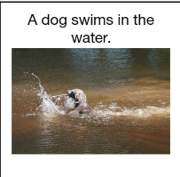
RESULTS
The result of the image captioning process is a descriptive caption generated by the model for a given input image.
This caption aims to accurately describe the content of the image in natural language.
The quality of the result can vary based on several factors, including the model architecture, the size and diversity of the training dataset, the effectiveness of the training process, and the suitability of the evaluation metrics used.
TO
https://github.com/Sathish1504/NaanMudhalvan-Project

